Slide 1

Integrating Smart agents with GITHUB COPILOT

Slide 2

AGENDA
Problem Statement
Proposed SOLUTION
User Experience with smart agents
Volt architecture
demo

Slide 3

PROBLEM STATEMENT
While GitHub Copilot excels at code completion, it lacks the contextual awareness of the problem developers are solving.
Developers often need to understand project requirements and locate dependent assets—such as documentation, design files, or configuration data—before they can effectively use Copilot.
This creates friction in the development process, as they must leave the development environment to access critical resources which can lead to inefficiencies.

Slide 4
Proposed SOLUTIOn
We propose integrating Smart Agents with GitHub Copilot to create a seamless development experience.
Access requirements directly from JIRA using Atlassian Rovo.
Build a dedicated smart agent for Discover that can search, retrieve, and manage Discover assets allowing developers to find everything they need effortlessly.
Combine the contextual capabilities of smart agents with Copilot’s code completion, enabling more accurate and informed code suggestions.

Slide 5
User Experience
with smart agents

Slide 6

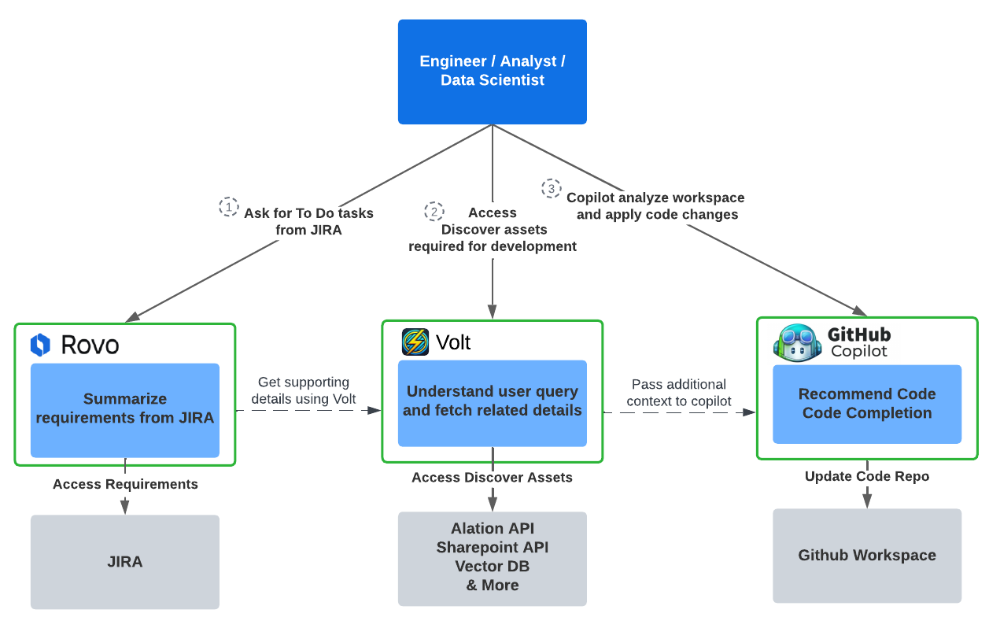

Slide 7
Volt
Architecture

Slide 8
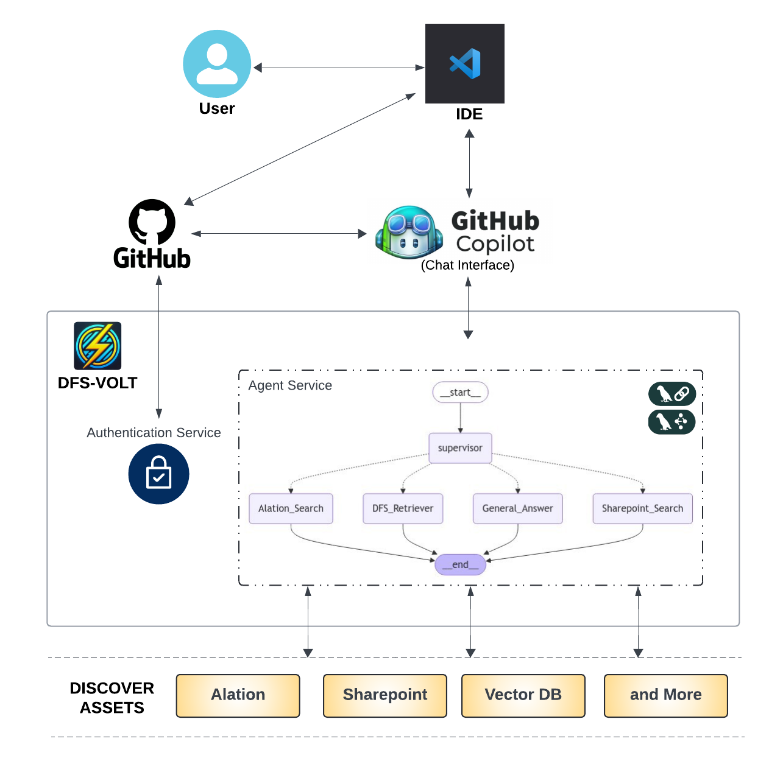

Slide 9
DEMO
https://vimeo.com/1022489701

Slide 10

THANK YOU
Developed By: Mayur Kumar
Github Link: https://github.com/mayur11235/volt_service

